Slide 1
Assigning Malaria to the Past: Ethiopia’s National Response to Malaria, its treatment and elimination
IV Corporate Africa Business Coalition Partnerships for Prevention & Care, Africa Health conference , Addis Ababa, 7-9 Feb 2011
By:
Daddi Jima (MD, MPh)
D/Director General, EHNRI

Slide 2
Global Malaria Epidemiology
Today approximately 40% of the world’s population is at risk of malaria
Malaria causes 300 - 500 million clinical cases and >1 million deaths per year, with about 90% of deaths and 60% of cases occurring in Africa, South of the Sahara.
It is responsible for 25%-45% of all outpatient clinic cases across Africa.

Slide 3
Global Malaria Epidemiology
Malaria accounts for one in five of all childhood deaths in Africa every year.
Malaria epidemic causes >12 million malaria episodes & up to 310,000 deaths in Africa annually
Malaria transmission occurs in 109 countries and territories.
These are areas between 45°N and 40°S latitude. These countries possess tropical or subtropical zones where optimal climatic condition favourable for the development of anopheline mosquito and parasites exists.

Slide 4
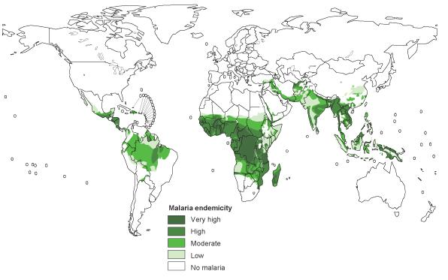
Malaria distribution and status of intervention

Slide 5
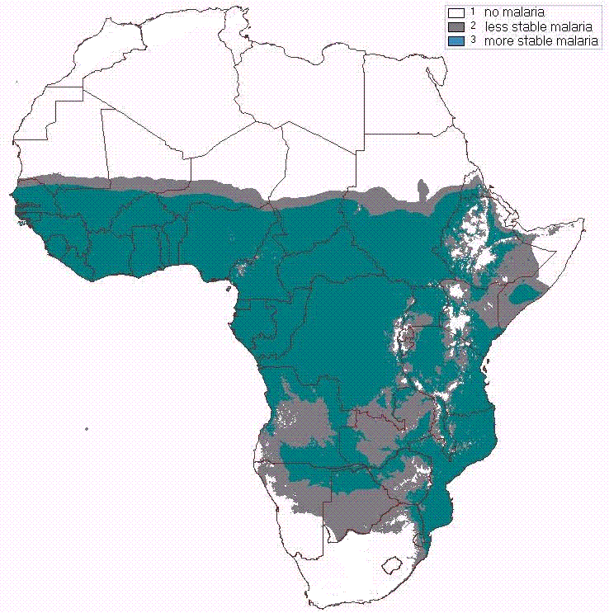
Africa Malaria Epidemiology
615 million Africans at risk
Less stable malaria – vulnerable populations … approx 125 million at risk
More stable malaria – vulnerable populations are approx 490 million

Slide 6
Ethiopia Malaria Epidemiology
75% of the land (<2000m) malarious
2/3 of the population at risk
Transmission - Major, September - December,
Minor, April - May

Slide 7
Ethiopia Malaria Epidemiology
Malaria is a major public health problem in Ethiopia
Every year it was the leading cause of out patient consultations, admissions and death
Recently, however, the rapid scale up of interventions has brought about significant decline in malaria burden

Slide 8
Important milestones in the control of malaria
1944-45 First indoor spraying with DDT in Italy, Venezuela, Guyana
1955 Adoption of the principle of malaria eradication by the 14th Word Health Assembly
1957-69 Worldwide malaria eradication programme (WHO)
1969 Revision of the global strategy of malaria eradication: need for greater involvement of general health services
1973-78 Marked resurgence of malaria in southern and south- eastern Asia
1978 Reorientation of malaria control strategy, following the recommendations of the International Conference of Primary Health Care held at Alma Ata.
1992 Adoption of the Global Malaria Control Strategy (Amsterdam)
1998 Roll Back Malaria as priority project of WHO

Slide 9
Important milestones in the control of malaria in Ethiopia
1959 Malaria Eradication Service established
One year after major malaria epidemic
Main strategy was Indoor residual spray
1971 Vertical Malaria Control Program
1993 Integrated and decentralized Control P.
Routine malaria control (including vector control) to be handed over to PHCUs

Slide 10
Main strategies
Early diagnosis and prompt treatment
Selective Vector control
Epidemic prevention and control
Supporting strategies
Human resource development
IEC
HMIS
Monitoring and Evaluation
Operational research

Slide 11
Achievements

Slide 12
rapid scale up of interventions for impact (quantity, quality & speed)
12

Slide 13
Key Malaria Control Goals and Targets
Global RBM Partnership Plan
To halve Malaria-associated mortality by 2010 and again by 2015.
Millennium Development Goals
Target 8: to have halted by 2015 and begun to reverse the incidence of Malaria and other major diseases.
Indicator 21. Prevalence and death rates associated with Malaria (WHO).
Indicator 22. Proportion of population in Malaria-risk areas using effective Malaria prevention and treatment measures (UNICEF/WHO).

Slide 14
Key Malaria Control Goals and Targets
National goals and targets
By 2015, achieve malaria elimination within specific geographical areas with historically low malaria transmission
By 2015, achieve near zero malaria transmission in the remaining malarious areas of the country
Objectives (see above)

Slide 15
Major Achievements: Diagnosis and Treatment
Target: Universal coverage of fever treatment within 24 hours of onset in 2009
RDT procurement and distribution, Procurement and distribution of Coartem

Slide 16
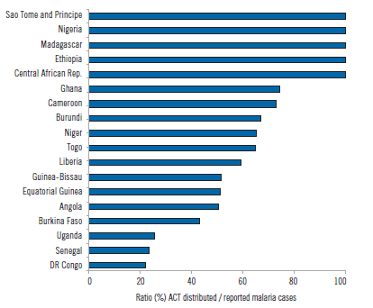
Source: WHO world malaria report 2009

Slide 17
Major Achievements: LLINs
Rapid scale up of ITNs in Ethiopia, 2000 - 2010
LLINs replaced
Cumulative number of LLINs distributed
Arrival of LLINs -Support from GFATM
Net with 6-month treatments

Slide 18
Net ownership and percentage of HH that received IRS - MIS 2007
100
90
RBM Global Strategic plan targets
80
70
RBM Abuja targets
60
50
MIS 2007 - national
MIS 2007 - <2000m
40
30
20
10
0
%HH with at least one ITN
% HH that received IRS
% of HH protected by ITNs or IRS

Slide 19
Net utilization – Children - MIS 2007
100
90
RBM Global Strategic plan targets
80
70
DHS 2005
RBM Abuja targets
60
MIS 2007
national
50
40
MIS 2007
<2000m
30
20
10
0
% children who slept under a net
% children who slept under an ITN
% children who slept under an ITN in HH with at least one ITN

Slide 20
Net utilization – Pregnant Mothers - MIS 2007
100
90
RBM Global Strategic plan targets
80
70
DHS 2005
RBM Abuja targets
60
MIS 2007
national
50
MIS 2007
<2000m
40
30
20
10
0
% pregnant women who slept under a net
% pregnant women who slept under an ITN
% pregnant women who slept under an ITN in HH with at least one ITN

Slide 21
Current Intervention Coverage Summary– MIS 2007
Indicators | DHS 2005 |  | MIS 2007
 | National | Malarious | National | Malarious
% of HH with at least one net (any net) | 5.7% | 10.7% | 55.7% | 69%
% of HH with at least one ITN | 3.4% | 6.4% | 53.3% | 66%
% use of nets (any nets) by children under five | 2.3% | 4.3% | 34.7% | 44%†
% use of ITNs by children under five | 1.5% | 2.8% | 33.1% | 42%†
% use of nets (any net) by pregnant women | 1.6% | 2.5% | 36.7% | 44%†
% use of ITNs by pregnant women | 1.1% | 1.6% | 35.2% | 43%†
% of children who had a fever in the two weeks preceding the survey | 18.7% | * | 22.3% | 24%
% of children with a fever who took an anti-malarial (within 24 hrs) | 3% (0.7%) | * | 9.5% (3.9%) | 12% (5%)
* “malarious areas” defined as areas <2000 meters elevation; 2005 DHS did not include this measure.
† among those in HH with a net, net-use rates for children or pregnant women were 60% and 66% respectively

Slide 22
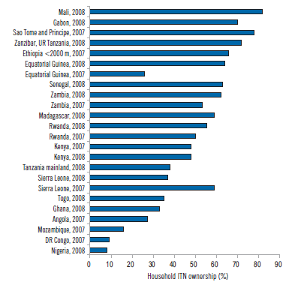

Slide 23
IMPACTS on Disease burden

Slide 24
Morbidity and mortality
24

Slide 25
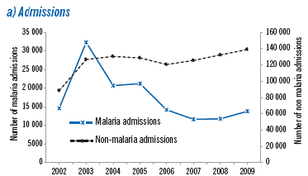
Malaria and non malaria admissions and deaths in Ethiopia, 2002–2009
Source: World malaria report, WHO, 2010

Slide 26
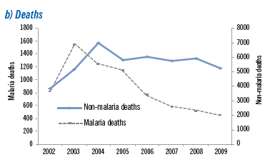
Malaria and non malaria admissions and deaths in Ethiopia, 2002–2009
Source: World malaria report, WHO, 2010

Slide 27
Malaria Epidemics Recorded, Ethiopia (July 2000 – June 2008)
Source: data collected from Regional Health Bureaus, FMOH

Slide 28
Malaria Burden
Weighted mean of percentage decline of malaria admission, death,
outpatient cases key malaria indicators in children under 5 year and >5 years, Ethiopia 2001-2007.
Age | admission | Death | OPD malaria | OPD malaria -confirmed | Slide positivity rate
> 5 years | -55% | -34% | -48% | -70% | ---
< 5 years | -52% | -56% | -47% | -61% | ---
All ages | -54% | -55% | -48% | -67% | -38%
Compared: Mean 2001 –2004 as baseline Vs 2007 data
Source: Global Malaria Program Department, WHO, Geneva

Slide 29
Future Direction

Slide 30
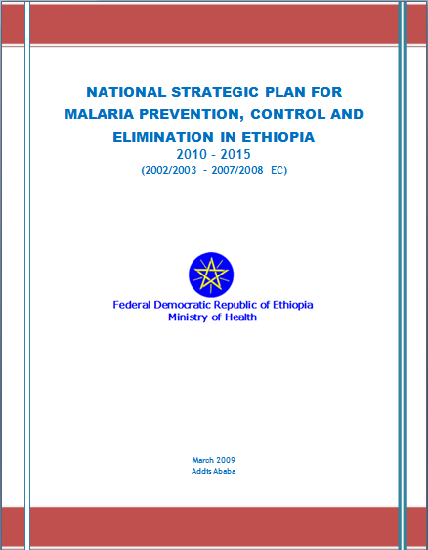
The Strategic Plan
Name: NATIONAL STRATEGIC PLAN FOR MALARIA PREVENTION, CONTROL AND ELIMINATION IN ETHIOPIA
Year covers: 2010 – 2015

Slide 31
1. Vision and Goals
Vision: To eliminate malaria nationwide by 2020
Goals:
By 2015, achieve malaria elimination within specific geographical areas with historically low malaria transmission
By 2015, achieve near zero malaria transmission in the remaining malarious areas of the country

Slide 32
Framework
GOALS
By 2015, achieve malaria elimination within specific geographical areas with historically low malaria transmission
By 2015, achieve near zero malaria transmission in the remaining malarious areas of the country
M
O
N
I
T
O
R
I
N
g
&
E
V
A
L
U
A
T
I
O
N
OBJECTIVES
Consolidate the achievements of the 2006-2010 National Strategic Plan, and sustain its impacts
STRATEGIES
Community empowerment and mobilization
Diagnosis and Case management, including active case detection
Prevention [LLINs distribution, IRS]
Active surveillance and epidemic control
Multi-program initiatives to strengthen the overall health system and capacity building

Slide 33
Why now?
Ethiopia has already scaled up all the malaria interventions

Slide 34
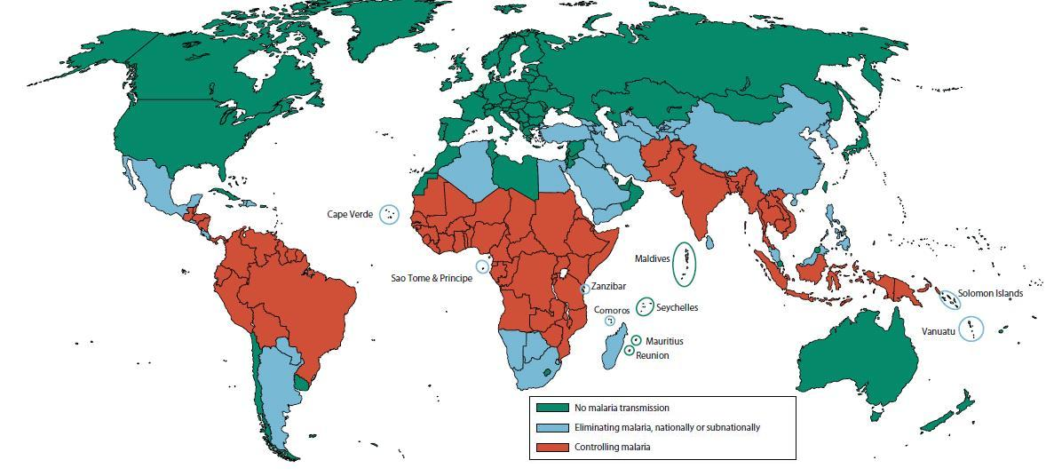
Malaria distribution and status of intervention

Slide 35
Why now?
There is significant reduction in burden
There is global commitment to eliminate malaria
There is high level commitment
Ample opportunity of funding
Extensive health expansion
There are good intervention strategies

